Slide 1
Structural Testing
Xiao-Xin Li
Zhejiang University of Technology

Slide 2
Blocks and Control-Flow Graph
A control-flow graph (or CFG) is a representation of all paths that might be traversed during the execution of a piece of code. It consists of basic blocks, decision blocks, and arrows/edges that connect these blocks.
basic blocks
decision blocks
arrows/edges

Slide 3
Counting words: An Example for Control-Flow Graph
Requirement:
Given a sentence, the program should count the number of words that end with either an "s" or an "r". A word ends when a non-letter appears.
public class CountLetters {
public int count(String str) {
1. int words = 0;
2. char last = ' ';
3. for (int i = 0; i < str.length(); i++) {
4. if (!Character.isLetter(str.charAt(i))
5. && (last == 's' || last == 'r')) {
6. words++;
7. }
8. last = str.charAt(i);
9. }
10. if (last == 'r' || last == 's')
11. words++;
12. return words;
}
You do not need to really understand the implementation!
But understanding Requirement is very important.

Slide 4
Counting words: An Example for Control-Flow Graph
public class CountLetters {
public int count(String str) {
1. int words = 0;
2. char last = ' ';
3. for (int i = 0; i < str.length(); i++) {
4. if (!Character.isLetter(str.charAt(i))
5. && (last == 's' || last == 'r')) {
6. words++;
7. }
8. last = str.charAt(i);
9. }
10. if (last == 'r' || last == 's')
11. words++;
12. return words;
}
To draw CFG, it is very important to know how many condition statements are contained in the program.

Slide 5
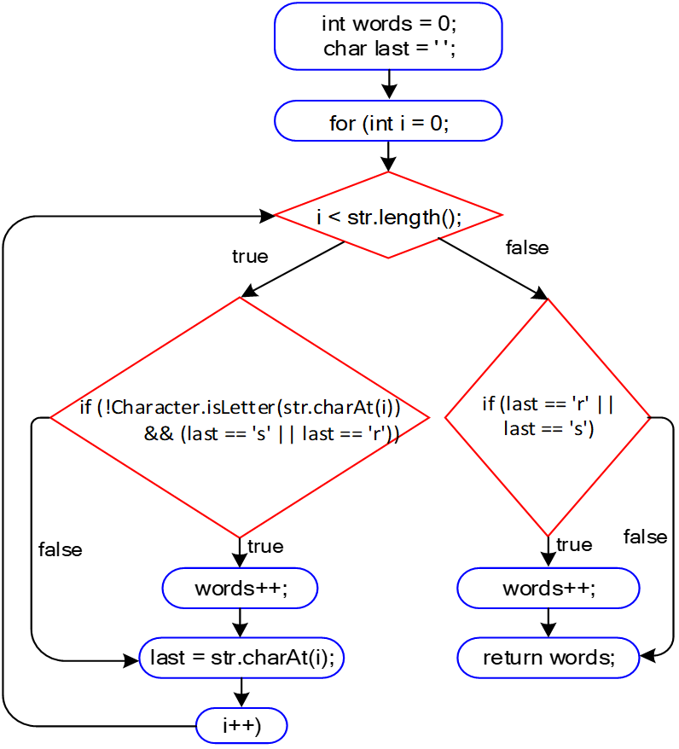
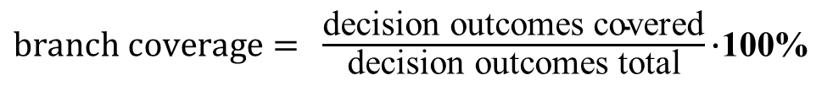
Branch/Decision coverage
$branch coverage= ​\frac{\text{decision} \text{outcomes} \text{covered}}{\text{decision} \text{outcomes} \text{total}}\text{⋅100\%}$​​
100% branch coverage can be achieved by the following two tests:
str = "cats|dogs"
str = "cats|dog"
However, branch coverage gives two branches for each decision, no matter how complicated or complex the decision is. When a decision gets complicated, i.e., it contains more than one condition like a > 10 && b < 20 && c < 10, branch coverage might not be enough to test all the possible outcomes of all these decisions.

Slide 6
For example, suppose one aims at testing the decision above: a > 10 && b < 20 && c < 10. Two tests can fully cover decision blocks (i.e., 100% branch coverage):
A test T1 (a=20, b=10, c=5) makes the condition true,
A test T2 (a=5, b=10, c=5) makes the condition false.
However, these two tests do not cover all the possibilities/different combinations for this decision to be evaluated to false; e.g., T3 (a=20, b=30, c=5), etc.

Slide 7
(Basic) condition coverage
When using condition coverage as a criterion, we split each compound condition into multiple decision blocks. This means each of the conditions will be tested separately, and not only the "big decision block".
To this end, we can re-design the CFG and make sure each decision block is now composed of a single condition.
With the new CFG in hands (and with it new edges to explore), it works the same as branch coverage. The formula is basically the same, but now there are more decision outcomes to count:
$condition coverage= ​\frac{\text{c}\text{onditions} \text{outcome} \text{covered}}{\text{conditions} \text{outcome} \text{total}}\text{⋅100\%}$​​

Slide 8
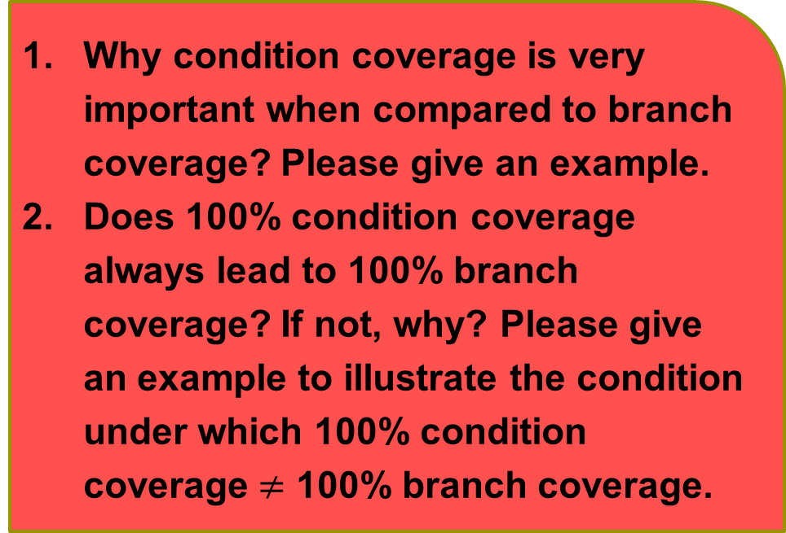
(Basic) condition coverage
Condition coverage now works the same as branch coverage, but has more decision outcomes to count.
Why condition coverage is very important when compared to branch coverage? Please give an example.
Does 100% condition coverage always lead to 100% branch coverage? If not, why? Please give an example to illustrate the condition under which 100% condition coverage $≠$ 100% branch coverage.

Slide 9
Condition + Branch coverage
void hello(int a, int b) {
if(a > 10 & b > 20) {
System.out.println("Hello");
} else {
System.out.println("Hi");
}
}

Slide 10
Condition + Branch coverage
100% basic condition coverage:
A test T1 = (20, 10) causes the first condition a > 10 to be true, and the second condition b > 20 to be false.
A test T2 = (5, 30) makes the first condition false, and the second condition true.
T1 and T2 together achieve 100% basic condition coverage. After all, both conditions a and b have been exercised as both true and false.
However, the final outcome of the entire decision was false in both tests. We never saw this program printing "Hello". We found a case where we achieved 100% basic condition coverage, but only 50% branch coverage. This is not a smart testing strategy. This is why looking only at the conditions themselves while ignoring the overall outcome of the decision block is called basic condition coverage.

Slide 11
The formula to calculate branch+condition coverage is as follows. Note how this formula gives us a clear differentiation between basic condition and decision+condition coverage:
$$\text{C}\text{/}\text{DC} \text{coverage}=\frac{\text{conditions} \text{outcome} \text{covered}\text{ + }\text{decisions} \text{outcome} \text{covered}}{\text{conditions} \text{outcome} \text{total}\text{ + }\text{decisions} \text{outcome} \text{total}}⋅100\%$$

Slide 12
Path Coverage
R = (A & (B | C))
Branch Coverage: {R = true, R = false}
Condition Coverage : A=true & (B=true | C=true) A=false & (B=false | C=false)
Path Coverage: Path coverage does not consider the conditions individually. Rather, it considers the (full) combination of the conditions in a decision. Each of these combinations is a path. You might see a path as a unique way to traverse the CFG.
How to understand this?

Slide 13
Truth/Decision Table
To get 100% path coverage, we would have to test all the possible combinations of these three conditions.
Truth Table for A & (B | C)
For n conditions in a decision, we have 2^{n} combinations of these n conditions. Why?
Tests | A | B | C | Outcome
1 | T | T | T | T
2 | T | T | F | T
3 | T | F | T | T
4 | T | F | F | F
5 | F | T | T | F
6 | F | T | F | F
7 | F | F | T | F
8 | F | F | F | F

Slide 14
Problem of Path Coverage
The number of tests needed for full path coverage will grow exponentially with the number of conditions in a decision.
Achieving 100% path coverage might not always be feasible or too costly.

Slide 15
Lazy vs. Eager Operators
Lazy Truth Table for A & (B | C)
('dc' represents "don't care" values.)
Tests | A | B | C | Outcome
1 | T | T | dc | T
2 | T | F | T | T
3 | T | F | F | F
4 | F | dc | dc | F
If the A is false, then the rest of the expression will be not evaluated anymore, because the result of the entire statement will be automatically false.
For the 2nd part of the expression, if B is true, then the entire proposition (B || C) is already true, so we "don't care" about the value of the C.

Slide 16
Loop Boundary Adequacy (LBA)
When there is a loop, the block inside of the loop might be executed many times, making testing more complicated.
unbounded loops: while(true) loop
long-lasting loops: for(i = 0; i < 10; i++) loop
Given that exhaustive testing is impossible, testers often rely on the loop boundary adequacy criterion to decide when to stop testing a loop. A test suite satisfies this criterion if and only if for every loop:
A test case exercises the loop zero times;
A test case exercises the loop once;
A test case exercises the loop multiple times.

Slide 17
Idea behind the LBA criterion
The idea behind the LBA criterion is to make sure the program is tested when the loop is never executed (does the program behave correctly when the loop is simply 'skipped'?), when it only iterates once (as we empirically know that algorithms may not handle single cases correctly), and many times.
The main challenge comes when devising the test case for the loop being executed multiple times. Should the test case force the loop to iterate for 2, 5, or 10 times? Our suggestion for testers is to rely on specification-based techniques.

Slide 18
MC/DC (Modified Condition/Decision Coverage)
Modified condition/decision coverage (MC/DC) looks at the combinations of conditions like path coverage does. However, instead of aiming at testing all the possible combinations, MC/DC identifies the "important" combinations.
The idea of MC/DC is to exercise each condition in a way that it can, independently of the other conditions, affect the outcome of the entire decision. In short, this means that every possible condition of each parameter must have influenced the outcome at least once.
Cost-wise, a relevant characteristic of MC/DC coverage is that, supposing that conditions only have binary outcomes (i.e., true or false), the number of tests required to achieve 100% MC/DC coverage is, on average, N+1, where N is the number of conditions in the decision. Note that N+1 is definitely smaller than all the possible combinations (2^{N}​​)!

Slide 19
An Example for MC/DC
/** Function:
* A program that decides whether an applicant
* should be admitted to the 'University of Character‘.
*/
void admission(boolean degree, boolean experience, boolean character) {
if (character && (degree || experience)) {
System.out.println("Admitted");
} else {
System.out.println("Rejected");
}
}
A
&&
(
B
||
C
)

Slide 20
Independence Test Pairs
Truth Table for
R = A && (B || C)
Independence Test Pairs. For a pair of test cases, if the value of R can be changed by the value of A when the values of B and C are fixed, we call the two test cases are a independence pair for A. That is, A can independently affect the overall outcome in these test cases.
MC/DC :
Find independence test pairs for each condition.
Choose only one independence test pair for each condition. The combination of these independence test pairs should have minimum test cases.
Tests | A | B | C | R
1 | T | T | T | T
2 | T | T | F | T
3 | T | F | T | T
4 | T | F | F | F
5 | F | T | T | F
6 | F | T | F | F
7 | F | F | T | F
8 | F | F | F | F

Slide 21













independence pairs of A/B/C in A && (B || C)
A
B
C
Tests | A | B | C | R
1 | T | T | T | T
2 | T | T | F | T
3 | T | F | T | T
4 | T | F | F | F
5 | F | T | T | F
6 | F | T | F | F
7 | F | F | T | F
8 | F | F | F | F
Tests | A | B | C | R
1 | T | T | T | T
2 | T | T | F | T
3 | T | F | T | T
4 | T | F | F | F
5 | F | T | T | F
6 | F | T | F | F
7 | F | F | T | F
8 | F | F | F | F
Tests | A | B | C | R
1 | T | T | T | T
2 | T | T | F | T
3 | T | F | T | T
4 | T | F | F | F
5 | F | T | T | F
6 | F | T | F | F
7 | F | F | T | F
8 | F | F | F | F
√
$$×$$
√
$$√$$
√
$$×$$
$$×$$
$$√$$
√
$$×$$
√
$$×$$
√
$$×$$
$$×$$
$$×$$
$$\left\{\left\{1,5\right\},\left\{2,6\right\},\left\{3,7\right\}\right\}$$
$$\left\{\left\{2,4\right\} \right\}$$
$$\left\{\left\{3,4\right\} \right\}$$

Slide 22
Choose the final test cases from Candidate Subsets
We now have all the pairs for each of the parameters:
A: {1, 5}, {2, 6}, {3, 7}
B: {2, 4}
C: {3, 4}
Having a single independence pair per variable (A, B and C) is enough. After all, we want to minimize the total number of tests, and we know that we can achieve this with N+1 tests.
We do not have any choices with conditions B and C, as we found only one pair of tests for each parameter. This means that we have to test combinations 2, 3 and 4.
Lastly, we need to find the appropriate pair of A. Note that any of them would fit. However, we want to reduce the total amount of tests in the test suite (and again, we know we only need 4 in this case).

Slide 23
Choose the final test cases from Candidate Subsets
We now have all the pairs for each of the parameters:
A: {1, 5}, {2, 6}, {3, 7}
B: {2, 4}
C: {3, 4}
If we were to pick either test 1 or test 5, we would have to include either test 5 or test 1 as well, as they are their opposites, but therefore unnecessarily increasing our number of tests.
In order to keep our test cases in accordance to N+1 or in this case 3+1, thus 4 test cases we can either add test 6 or test 7, as their opposites (test 2 or 3) are already included in our test cases. Randomly, we pick test 6.

Slide 24
Discuss some details about the MC/DC
The minimum/maximum number of tests required for MC/DC.
Mathematically speaking, N+1 is the minimum number of tests required for MC/DC coverage (and 2∗N the theoretical upper bound). However, empirical studies indeed show that N+1 is often the required number of tests.
masked MC/DC.
MC/DC coverage is not always achievable.

Slide 25
masked MC/DC
We have applied what we call unique-cause MC/DC criteria. We identify an independence pair (T1, T2), where only a single condition changes between T1 and T2, as well as the final outcome.
That might not be possible in all cases. For example, (A and B) or (A and C). Ideally, we would demonstrate the independence of the first A and B, the second A and C. It is however impossible to change the first A and not change the second A. Thus, we can not demonstrate the independence of each A in the expression. In such cases, we then allow A to vary, but we still fix all other variables (this is what is called masked MC/DC).

Slide 26
MC/DC coverage is not always achievable
It might not be possible to achieve MC/DC coverage in some expressions. See (A and B) or (A and not B). While the independence pairs (TT, FT) would show the independence of A, there are no pairs that show the independence of B.
While logically possible, in such cases, we recommend the developer to revisit the (degenerative) expression as it might had been poorly designed. In our example, the expression could be reformulated to simply A.
How to understand this?

Slide 27
Exercise 16.
Draw the truth table for expression A and (A or B).
Is it possible to achieve MC/DC coverage for this expression? Why (not)?
What feedback should you give to the developer, that used this expression, about your finding?

Slide 28
Truth table for
A and (A or B)
From this table we can deduce sets of independence pairs for each of the parameters:
A: {(1, 3), (2, 4)}
B: { (empty) }
We can see that there is no independence pair for B. Thus, it is not possible to achieve MC/DC coverage for this expression.
Since there is no independence pair for B, this parameter has no effect on the result. We should recommend the developer to restructure the expression without using B, which will make the code easier to maintain.
Tests | A | B | Result
1 | F | F | F
2 | F | T | F
3 | T | F | T
4 | T | T | T

Slide 29
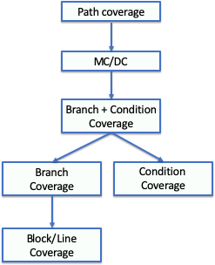
Criteria Subsumption
You might have noticed that the criteria we studied became more rigorous and demanding throughout this chapter. We started our discussion with line coverage. Then we discussed branch coverage, and we noticed that we could generate more tests if we focused on branches. Then, we discussed branch + condition coverage, and we noticed that we could generate even more tests, if we also focused on the conditions.
There is a relationship between these criteria. Some strategies subsume other strategies. Formally, a strategy X subsumes strategy Y if all elements that Y exercises are also exercised by X. You can see in the right figure the relationship between the coverage criteria we studied.

Slide 30
Other Topics
The effectiveness of structural testing
Structural testing vs structural coverage

